Slide 1

Department of Information Technology
A.P. Shah Institute of Technology
G.B.Road,Kasarvadavli, Thane(W), Mumbai-400615
UNIVERSITY OF MUMBAI
Academic Year 2020-2021

Slide 2
A Project Report on
AI Based Smart Attendance System
Submitted in partial fulfillment of the degree of
Bachelor of Engineering(Sem-8)
in
INFORMATION TECHNOLOGY
By
Jayesh Bhosale (17104014)
Tejas Bhanushali (17104031)
Yash Gangani (18204009)
Under the Guidance of
Prof. Anagha Aher Prof. Neha Deshmukh

Slide 3
1.Project Conception and Initiation
1.1 Abstract
1.2 Objectives
1.3 Literature Review
1.4 Problem Definition
1.5 Scope
1.6 Technology Stack
1.7 Benefits for environment & Society

Slide 4
1.1 Abstract
One necessary component of every education system is recording students attendance. The managing attendance manually can be a time-consuming task for the teacher. To resolve this problem, a smart attendance management system is being used.
The smart attendance system generally requires a biometrics method for execution. Face recognition is one of the best biometric methods to improve this system. By utilizing this smart system, the problem of proxies can easily be solve.
This project proposes a model for implementing a smart attendance management system for students of a class by making use of face recognition technique and sending alerts to parents about the student’s presence with the help of a message alert system. The parents will also be able to visualize their wards overall attendance with the help of a dashboard.

Slide 5
1.2 Objectives
To develop a smart attendance management system using facial recognition that will take care of the problems which are being faced in manual attendance systems.
To develop a message alert system to notify parents about ward's attendance.
To make a dashboard to review and visualize attendance of a student.
To make it useful not only to wards but also to faculties for scheduling or rescheduling the lectures.

Slide 6
1.3 Literature Review
Sr No. | Authors | Year | Methodology | Advantage | Disadvantage
1. | Smita Tripathi Varsha Sharma Sanjeev Sharma | 2011 | A new face detection method which combines the Skin Color Detector and the Template Matching Method. Template matching methods find the similarity between the input images and the template images (training images). | This method had a 98% face detection probability. | This method can't use one or more color spaces in the skin color detector.
2. | K. Simonyan Andrew Zisserman | 2014 | Visual Graphic Group(VCC) model for face recognition including. Illumination pre-processing algorithm. | This system can achieve 100% accuracy under good illumination. Environment of poor illumination the accuracy is 85.9% but accuracy is reach more than 90% through pre-processing. | Attitude and expression individual changes a lot when take photos which will have certain effect on face recognition results and illumination is too poor. The accuracy of this system is not constant.

Slide 7
1.3 Literature Review
Sr No. | Authors | Year | Methodology | Advantage | Disadvantage
3. | Florian Schroff Dmitry Kalenichenko James Philbin | 2015 | Author suggested method based on learning a Euclidean embedding per image using a deep convolutional network. The network is trained such that the squared L2 distances in the embedding space directly correspond. | Much greater representational efficiency. | Indirectness and its inefficiency.
4. | K. Goyal K. Agarwal Rishi Kumar | 2017 | Face localization can be referred to as extraction of facial features using pattern recognition system. Both MATLAB and Open CV can be used for creating such prototypes and systems. | Haar cascades works and gives better accuracy in facial expression. | Initially, it was time consuming.
5. | Madhuram B. Prithvi Kumar Lakshman Sridhar Nishanth Prem | 2018 | Author suggested Eigenfaces using grayscale images. this paper shows us that it is easy to covert color images to grayscale and then to apply Histogram Equalization. | Classification is fast, even when it's applied at serveral scales. | Assumes a fixed scale for the face.

Slide 8
1.4 Problem Definition
To record the attendance can be a great burden on the faculties if it is done by manually, and sending report of each student's attendance to respective parents also becomes tedious.
To schedule the lectures for faculties at given time slot becomes easy.
To provide visualization of ward’s attendance can be easily done by parents.
By utilizing this framework, the problem of proxies and students being marked present even though they are not physically present can easily be solved.

Slide 9
1.5 Scope
To record attendance manually it can be a tedious task, So we provide dashboard. Using that dashboard admin can register to students, faculties and parents. Also they can schedule the lecture and view the attendance.
Faculty have permission to schedule the lecture, generate the defaulter list and send the notification to the parent. If the student attendance marked as an absent but student are present in the lecture then faculty can easily modify the attendance using edit attendance tab.
Students and Parents can visualize the attendance using dashboard.

Slide 10
1.6 Technology stack
Python3 (libraries required OpenCV).
HTML, CSS.
MySQL.
Tableau.
Flask web framework.

Slide 11
1.7 Benefits for environment & Society
Our system is environment friendly since, it will help to reduce the manual paper attendance hence it saving cost and paper.
Our system will help teachers to manage the attendance efficiently.
Using our system student can visualize their attendance.
Parents can also visualize their ward’s attendance.

Slide 12
2. Project Design
2.1 Proposed System
2.2 Design(Flow of Modules)
2.3 Description of Use Case
2.4 Activity Diagram
2.5 Class Diagram
2.6 Module

Slide 13
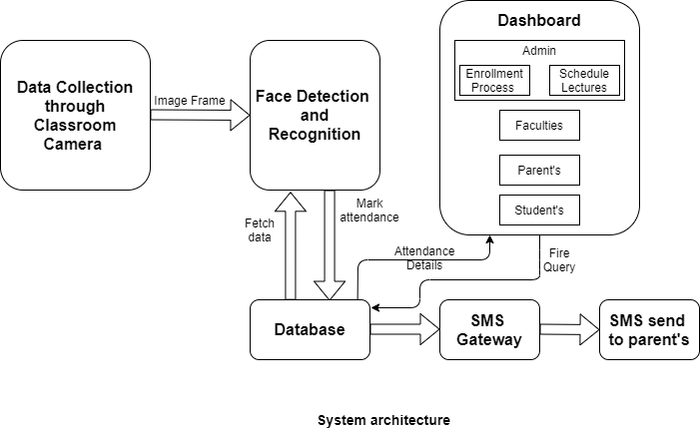
2.1 Proposed System
Figure 2.1.1:

Slide 14
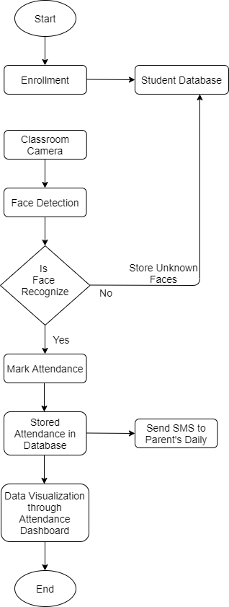
2.2 Design(Flow Of Modules)
Figure 2.2.1: Flow of Modules

Slide 15
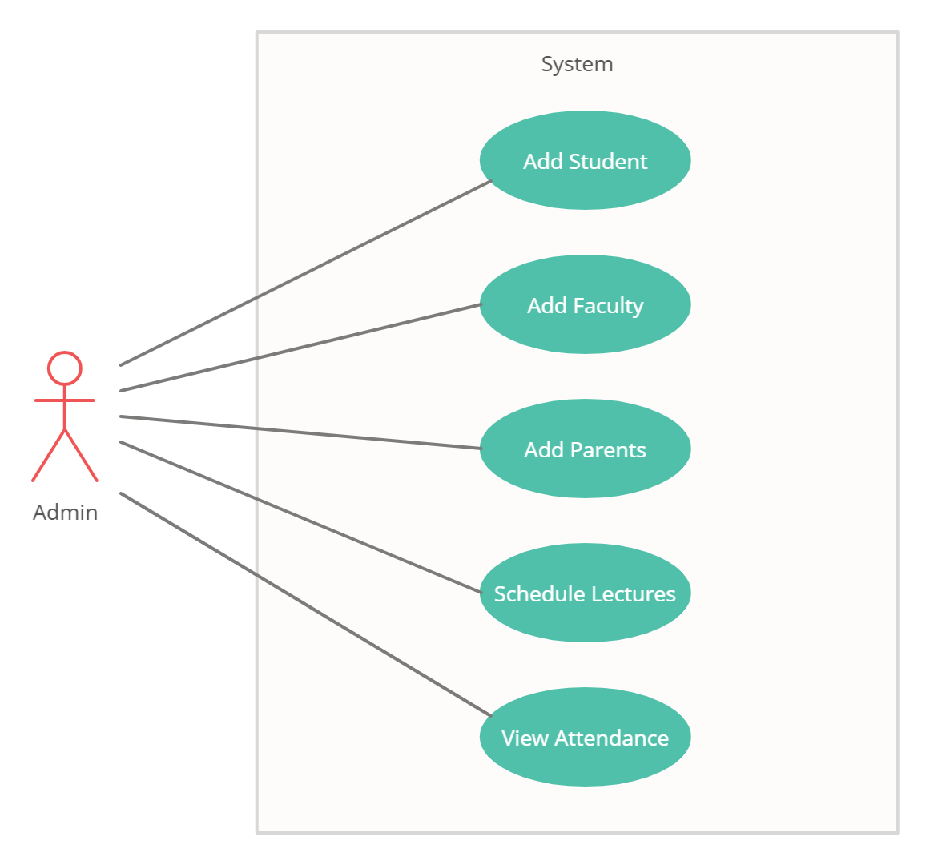
2.3 Description Of Use Case
Figure 2.3.1: Use Case for Admin
In the above diagram Admin is an actor. Admin can register to students, faculties and parents. Also admin can schedule lectures and view the attendance.

Slide 16
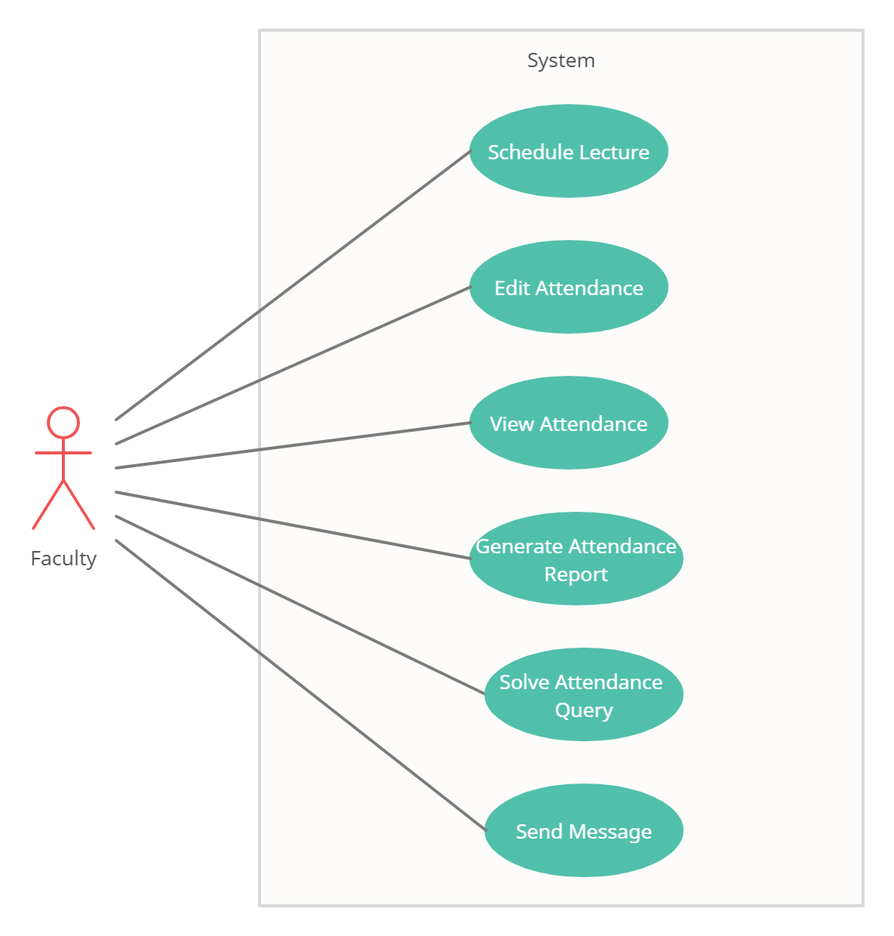
2.3 Description Of Use Case
Figure 2.3.2: Use Case for Faculty
In the above diagram Faculty is an actor. Faculty can schedule lectures, edit attendance, view the attendance, generate attendance report and solve attendance query. Faculty can also be able to send attendance related notification to the parents through SMS.

Slide 17
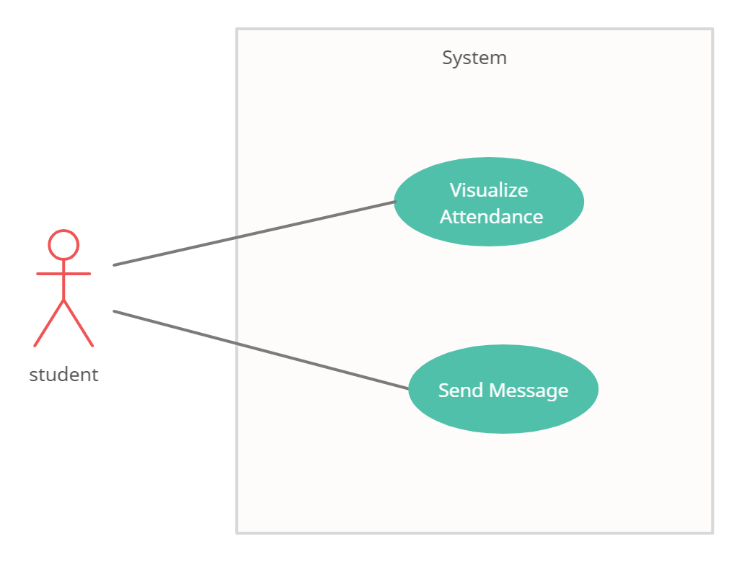
2.3 Description Of Use Case
Figure 2.3.3: Use Case for Student
Here in the above diagram Student is an actor. Student can visualize their attendance and send message if they have any query related to the attendance.

Slide 18
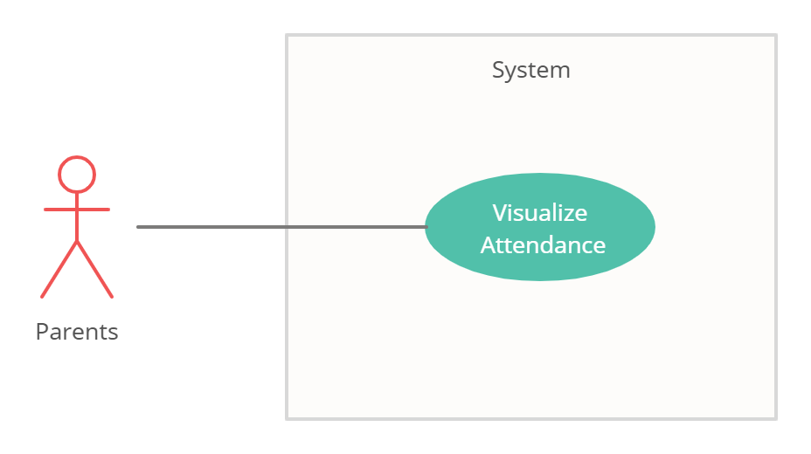
2.3 Description Of Use Case
Figure 2.3.4: Use Case for Parents
In the above figure Parents is an actor. Parent can visualize their ward’s attendance using dashboard.

Slide 19
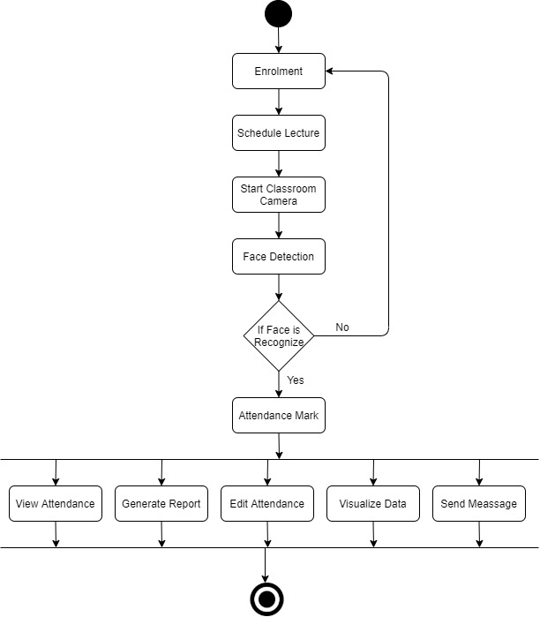
2.4 Activity Diagram
Figure 2.4.1: Activity Diagram

Slide 20
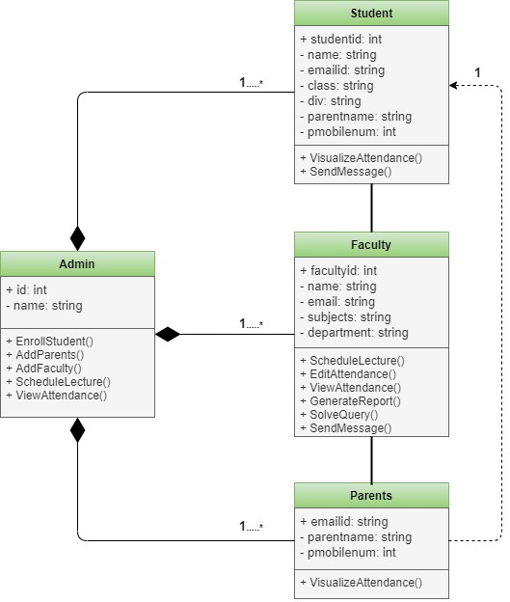
2.5 Class Diagram
Figure 2.5.1: Class Diagram

Slide 21
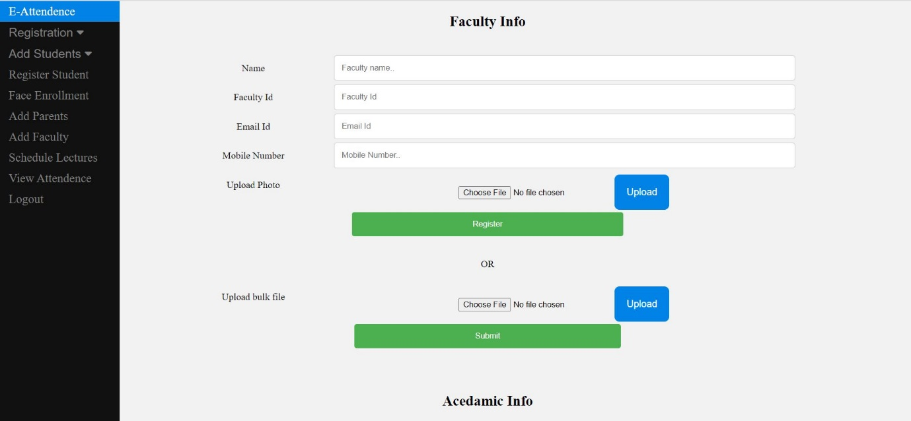
2.6 Module-1: Enrolment
Figure 2.6.1: Faculty Enrolment

Slide 22
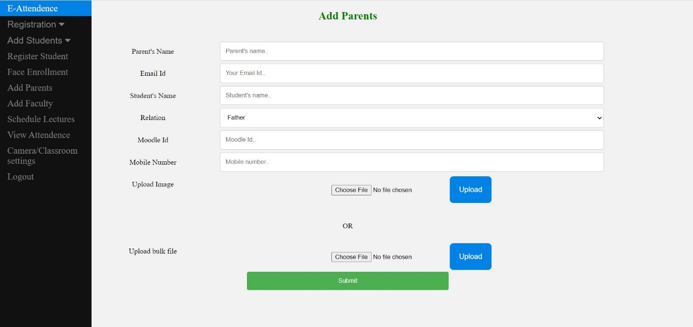
Module-1: Enrolment
Figure 2.6.2: Parents Enrolment

Slide 23
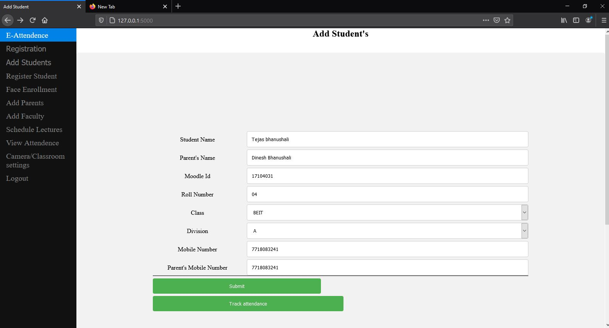
Module-1: Enrolment
Figure 2.6.3: Student Enrolment

Slide 24
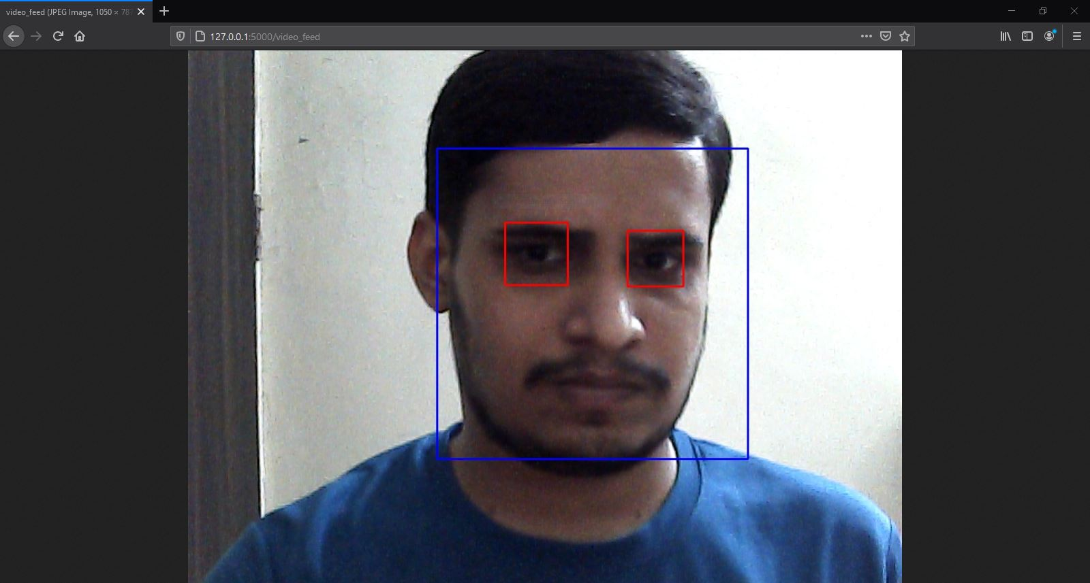
Module-1: Enrolment
Figure 2.6.4: Student Face Enrolment

Slide 25
Module-2: Face Detection and Recognition
Figure 2.6.5: Face Detection

Slide 26
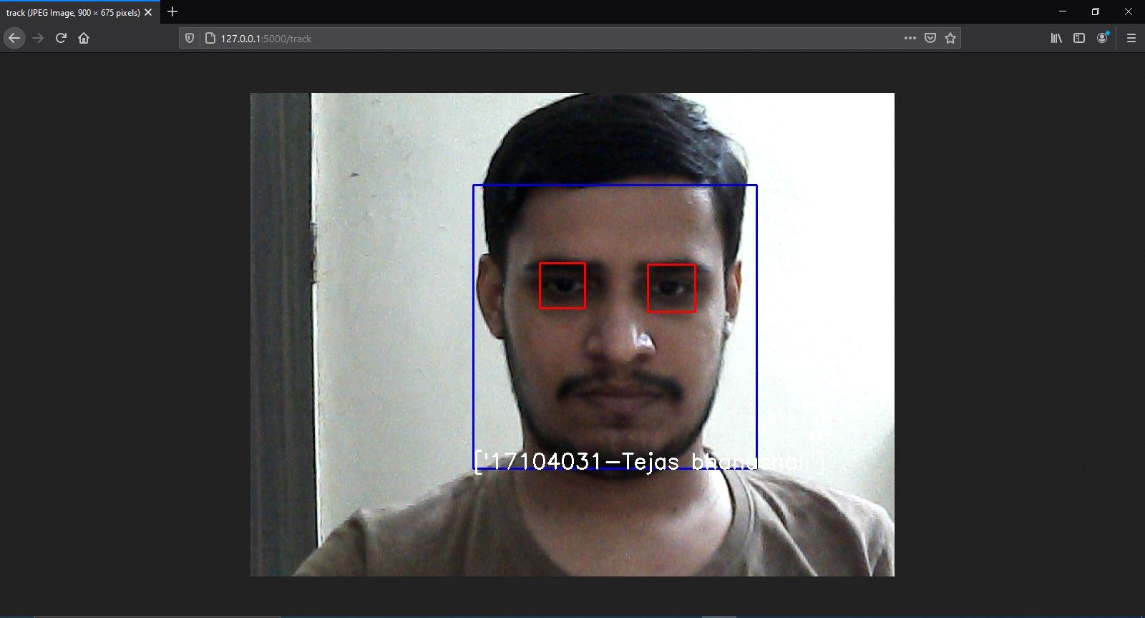
Module-2: Face Detection and Recognition
Figure 2.6.6: Face Recognition

Slide 27
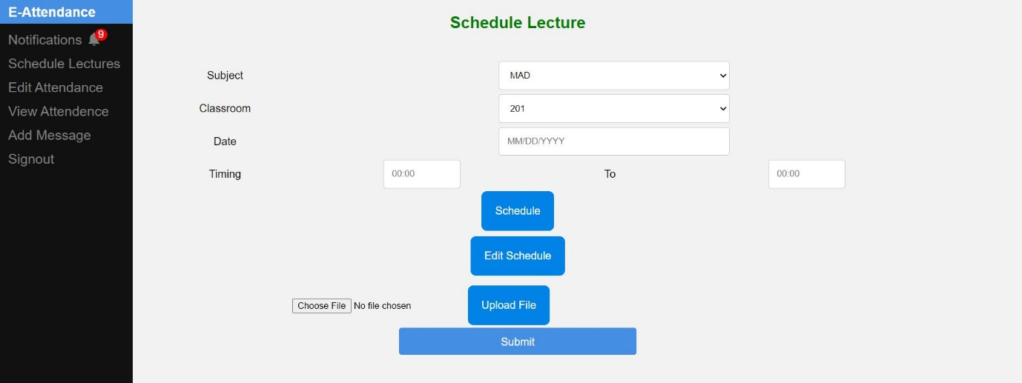
Module-3: Dashboard
Figure 2.6.7: Schedule Lecture

Slide 28
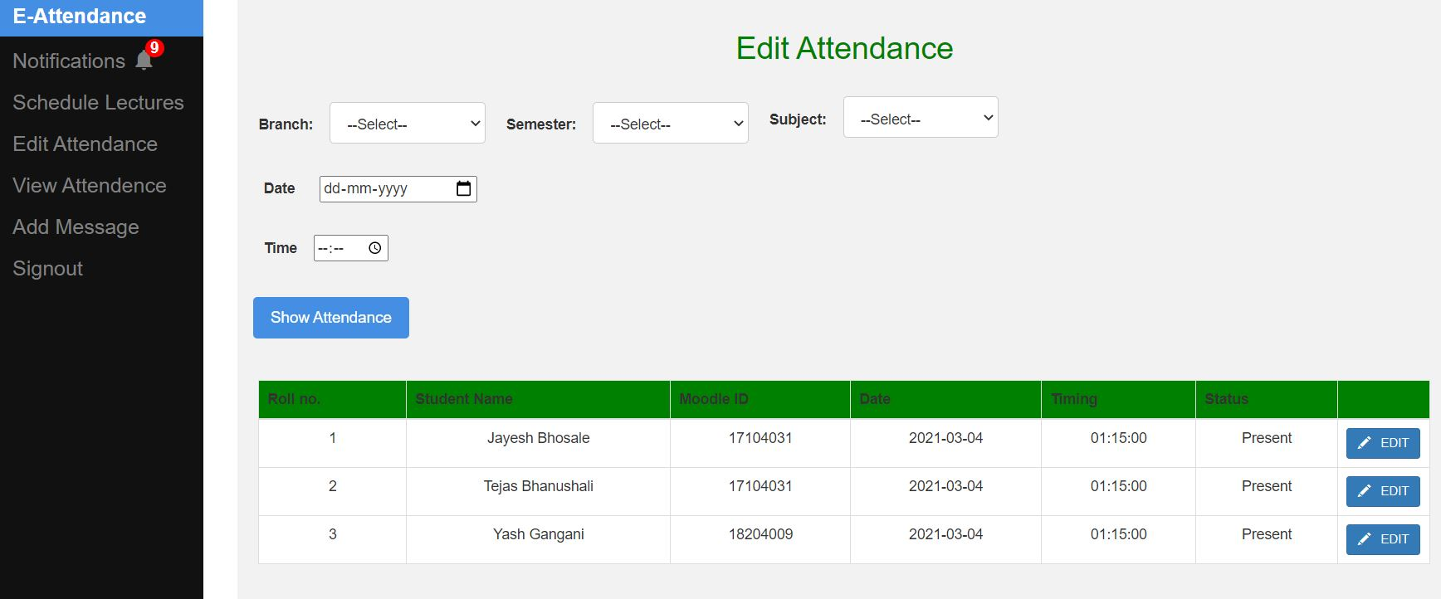
Module-3: Dashboard
Figure 2.6.8: Edit Attendance

Slide 29
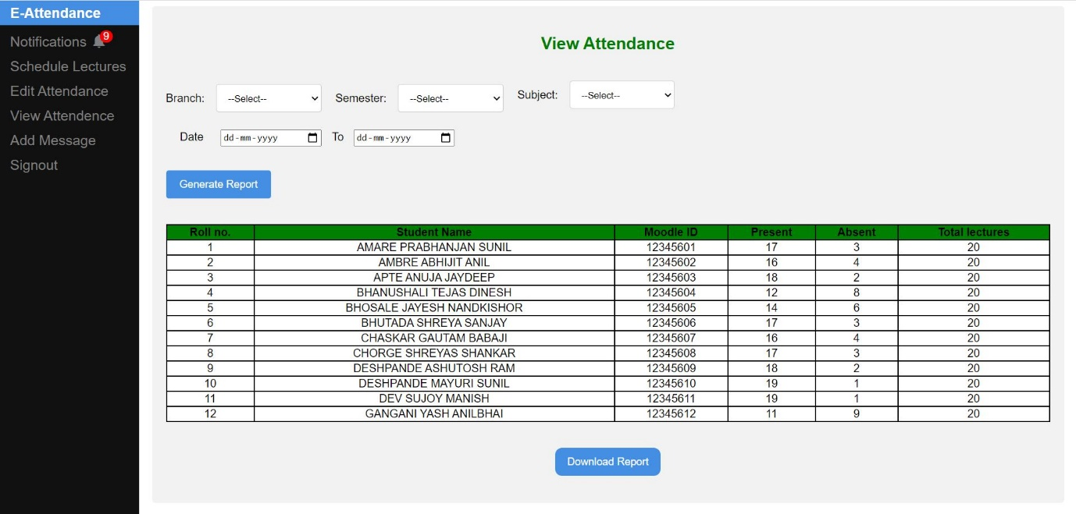
Module-3: Dashboard
Figure 2.6.9: View Attendance

Slide 30
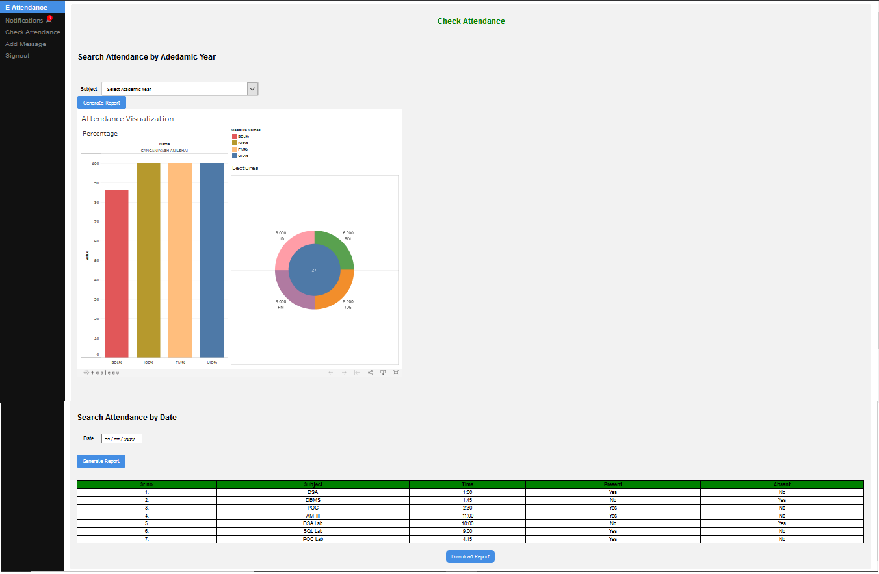
Module-4: Data Visualization Through Dashboard
Figure 2.6.10: Visualize Attendance Data

Slide 31
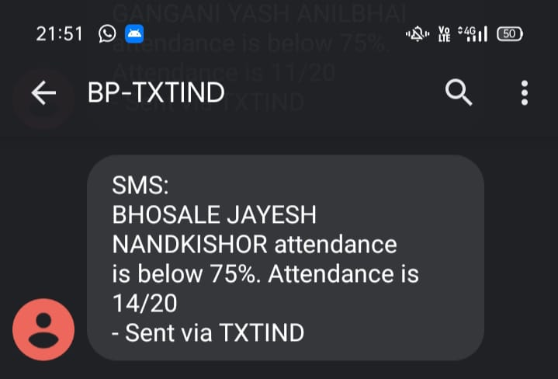
Module-5: SMS alert System
Figure 2.6.11: SMS Send To Parents

Slide 32
3. Conclusion and Future Scope

Slide 33
3. Conclusion and Future Scope
We have implemented an AI based smart attendance system. Which is used for taking attendance by tracking the student’s face and comparing the face data using data set of pretrained data of student’s face. We used Haar Cascade algorithm for face detection and face recognition. Our system is helpful for parents and students to see and visualize the attendance through dashboard. Our system is also helpful for faculty to schedule lecture and send notification to the parents related to their ward’s attendance.
In the future, by making small updates to the system it might be able to track student’s emotions through which the attention of students can be monitored, also during the examination it would be helpful to determine the ethics of students using emotion trackers in the system.

Slide 34
4. References

Slide 35
4. References
P.C Mahalanobis, ”On the Generalized Distance in Statistics”, Published by National Institute of Sciences of India, January 4, 1936.
Marko Heikkila , Mtti Pietikainen, ordelia Schmidf ”Description of interest regions with local binary patterns”, in Pattern Recognition, Volume 42, Issue 3 - March, 2009.
K. Simonyan, Andrew Zisserman, ”Very Deep Convolutional Networks for Large-Scale Image Recognition”, 4 Sep, 2014.
Madhuram.M, B. Prithvi Kumar, Lakshman Sridhar, Nishanth Prem, ”Face Detection and Recognition Using OpenCV” in IRJET Volume: 05 Issue, Oct, 2018.

Slide 36
4. References
M. Arsenovic, S. Skadojevic and A. Anderla, ”FaceTime- Deep Learning Based Face Recognition Attendamce system.,” in IEEE 15th International Symposium onIntelligent Systems and Informatics, Serbia, 2017.
K. Goyal, K. Agarwal and R. Kumar, ”Face Detection and tracking using OpenCV,”in International Conference on Electronics, Communication and Aerospace Technology, ICECA 2017, 2017.
Smita Tripathi, Varsha Sharma (2011),” Face Detection using Combined Skin Color Detector and Template Matching Method”. International Journal of Computer Applications Volume 26– No.7.
Kirby and Sirovich, 1990. Application of KarhunenLoeve procedure for the characterization of human faces. IEEE Trans. pattern analysis and machine intelligence, 12:103-108

Slide 37
Thank You

